Slide 1
Exception Handling
in java

Slide 2
Exceptions
To err is human- as a human being we commit many errors.
A software engineer may also commit several errors while designing the project or developing the code. These errors also called as ‘bugs’ and process of removing the them is called ‘debugging’.
So let us take a look at different types of errors that are possible in a program.

Slide 3
Errors in java
There are three types of errors:
Compile time error
Runtime error
Logical error.
Compile time error: These are syntactical errors found in the code, due to which a program fails to compile.
Detecting and correcting the errors is easy as the compiler will list the errors with line number.

Slide 4
Runtime error: These errors represents the inefficiency of the system to execute a particular statement.
Ex: insufficient memory, power shut down etc.
Runtime errors are detected by the JVM and compiler cannot detect it.
Logical error: These errors depict the flaws in the logic of program. Wrong formula or design of the program, these errors cannot be detected by compiler or JVM.
The programmer is sole responsible

Slide 5
Runtime error.
package exception;
public class Error {
public static void main() {
// TODO Auto-generated method stub
double sal = 5000.00;
sal = sal*15/100;// sal = sal+sal*15/100;
System.out.println(sal);
}
}
o/p
Error: Main method not found in class exception.Error, please define the main method as:
public static void main(String[] args)
or a JavaFX application class must extend javafx.application.Application

Slide 6
Logical error
package exception;
public class Error {
public static void main(String[] args) {
// TODO Auto-generated method stub
double sal = 5000.00;
sal = sal*15/100;// sal = sal+sal*15/100;
System.out.println(sal);
}
}

Slide 7
Exceptions
Basically an exception is a run time error.
Then there is a doubt:
Can’t I call a compile time error an exception?
The answer is “No you cannot call compile time errors also exceptions.
They come under errors.
All exceptions occur only at run time but some exceptions are detected at compile time and some others at runtime.
Compile time exceptions- checked exceptions- Java compiler
Runtime exceptions- unchecked exceptions- By JVM

Slide 8
Unchecked exceptions and errors are considered as unrecoverable and the programmer cannot do anything when they occur.
The programmer can write a java program with unchecked exceptions and errors and can compile the program.
He can see their effect only when he runs the program.
So java compiler allows him to write a java program with out handling the unchecked exceptions and errors.

Slide 9
In case of other exceptions(checked), the programmer should either handle them or throw them with out handling.
So he cannot simply ignore them, as java compiler will remind him of them.
public static void main(String[] args) throws IOException
So, we threw it of main() method with out handling, this can done by throws clause written after main() method in the above statement.
Suppose if we are not handling or not even throwing it, then the java compiler will give an error.
The point is that exception occurs at run time but in case of checked exceptions, whether you are handling it or not, it is detected at compile time. So let us define exception as a run time error that can be handled by programmer.

Slide 10
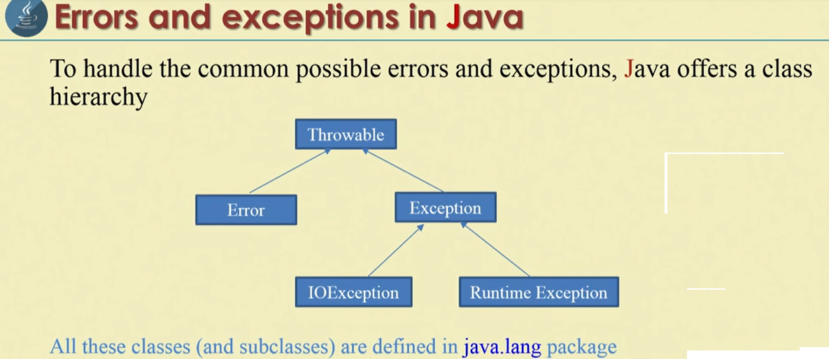
This means a programmer can do something to avoid any harm caused by the rise of an exception.
In case of an error, the programmer cannot do anything and hence if error happens, it cause some damage.
All exceptions are declared as classes in java.

Slide 11
Interview questions:
What is Throwable?
Throwable is a class that represents all errors and exceptions which may occur in java.
Which is the super class for all exceptions?
Exception is the super class of all exceptions in java.
What is the difference between an exception and an error?
An exception is an error which can be handled. It means when an exception happens , the programmer can do something to avoid any harm. But an error is an error which cannot be handled. It happens and the programmer cannot do anything.

Slide 12
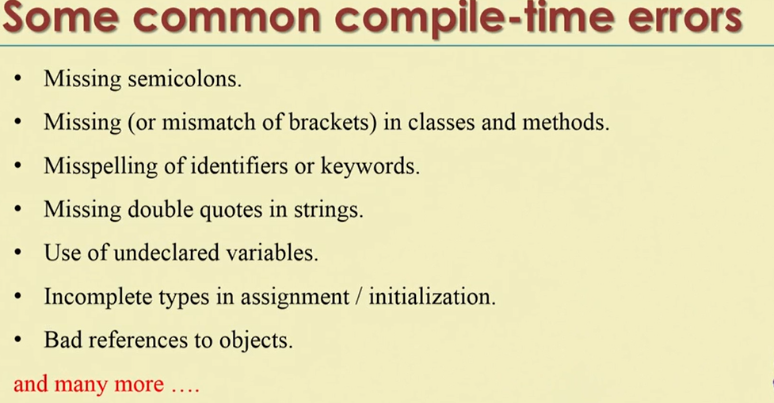

Slide 13
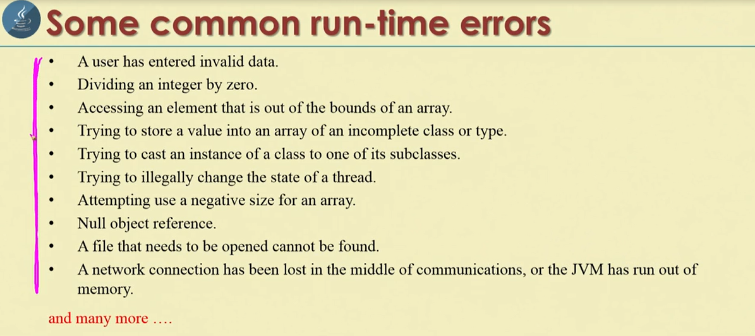

Slide 14
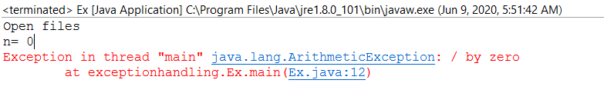
Program to open the files in the beginning. Then the number of command line arguments is accepted into n. then divide a number 45 and the result is stored into a. Finally the files are closed.
package exceptionhandling;
public class Ex {
public static void main(String[] args) {
// TODO Auto-generated method stub
//
System.out.println("Open files");
// do some processing
int n= args.length;
System.out.println("n= "+n);
int a =45/n;
System.out.println("a= "+a);
// close the files
System.out.println("Close the files");
}
}

Slide 15
Int a=45/n;
If divided by zero it will give infinity and the value cannot be stored in any variable.
So there will be an exception at run time and JVM displays exception details and then terminates the program abnormally.
The subsequent statements are not executed.
Means files opened are not closed properly and we may lose data.
This is the major problem with exceptions. When there is an exception, the files may not be closed properly or threads may abnormally terminate or the memory may not be freed properly.
Things lead to many other problems.
So closing the opened files,stoping any running threads and release the unused memory are called “cleanup operations”.
Therefore it is compulsory to design the program even there is an exception, all the clean up operations are performed and program should be terminated.
This is called “Exception Handling”;

Slide 16
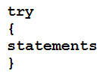
Exception Handling
When there is an exception, the user data may corrupt. This should be handled properly by the programmer by carefully designing the program.
Follow three steps:
Step 1:
The programmer should observe the statements in his program where there may be a possibility of exceptions. Such statements should be written inside a try block.
The greatness of try block is that even if some exceptions arises inside, the program will not be terminated. When JVM understand that there is some error in the program.
When JVM understand there is an exception, it stores the exception stack and then jumps into a catch block.

Slide 17
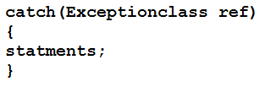
Step 2:
The programmer should write the catch block where he should display the exception details to the user.
This helps user to understand that there is some error in the program.
The programmer should also display a message regarding what can be done to avoid this error.
Catch block:

Slide 18
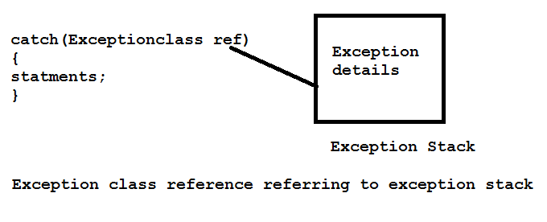
The reference ref above is automatically adjusted to refer to the exception stack where the details of the exception available, as shown in below figure.
We can display the exception in any one of the ways:
Using print() or println() such as System.out.println(ref).
Using printStackTrace() method of Throwable class, which fetches exception details from the exception stack and displays them.

Slide 19
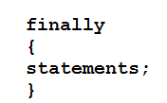
Step 3:
Lastly the programmer should perform the cleanup operations like closing the files, terminating the threads etc.
The specialty of the finally block is the statements inside the finally block are executed irrespective of whether there is an exception or not.
This ensures that all the opened files are properly closed and all running threads are properly terminated.
So data in the files will not be corrupted and the user is at safe side.

Slide 20
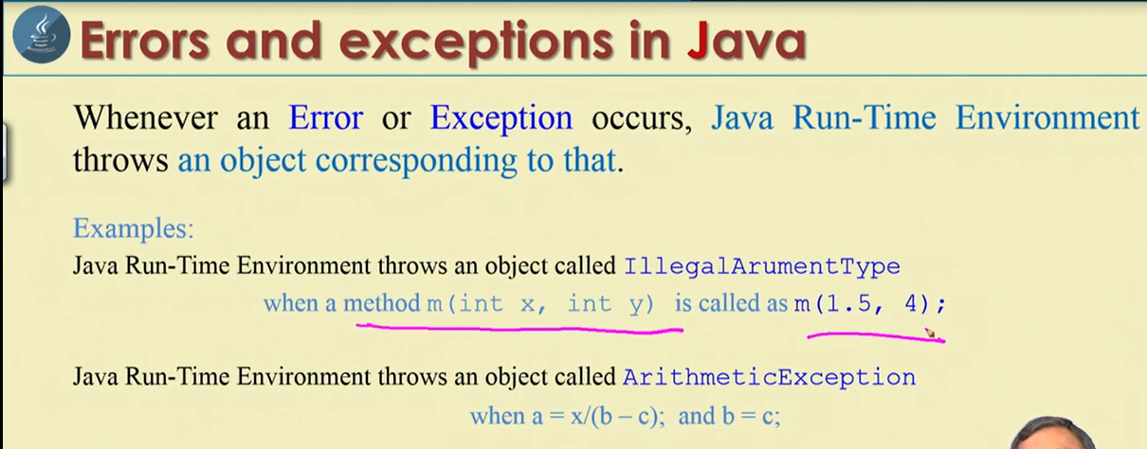

Slide 21
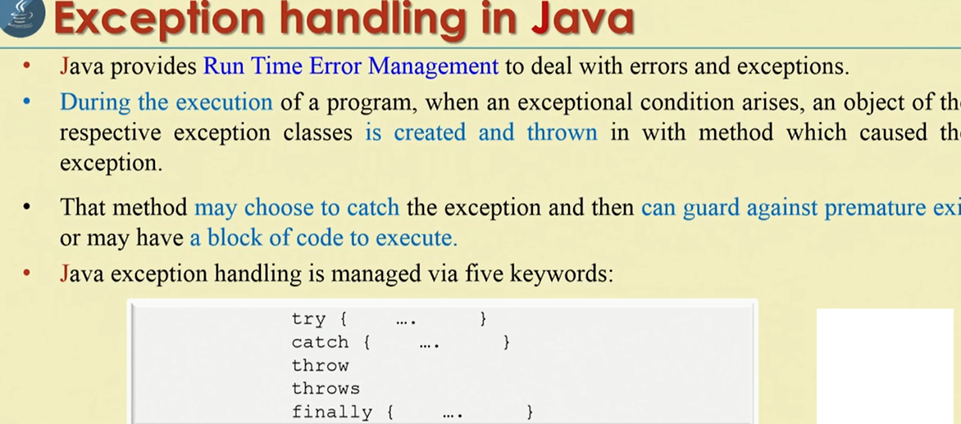

Slide 22
After adding try, catch and finally.
package exceptionhandling;
public class Ex {
public static void main(String[] args) {
// TODO Auto-generated method stub
try{
System.out.println("Open files");
// do some processing
int n= args.length;
System.out.println("n= "+n);
int a =45/n;
System.out.println("a= "+a);
}
catch(ArithmeticException ae)
{
System.out.println(ae);
System.out.println(" Please pass data while running this program");
}
// close the files
finally{
System.out.println("Close the files");
}
}
}
A

Slide 23
Multiple catch
package exception;
public class Ex {
public static void main(String[] args) {
// TODO Auto-generated method stub
// opening the files
try{
System.out.println("Opening files");
// doing some process
int n = args.length;
System.out.println("arguments n "+n);
int a = 45/n;
System.out.println("a"+a);
int b[]={10,20,30};
b[50]=100;
}
//catch(Exception e){
//e.printStackTrace();
//}
catch(ArrayIndexOutOfBoundsException aie)
{
//
System.out.println(aie);
aie.printStackTrace();
//System.out.println(" Please give the array index with in the range");
}
catch(ArithmeticException ae)
{
System.out.println(ae);
ae.printStackTrace();
//ae.getMessage();
//System.out.println(" Please pass data while running this program");
}
//closing the file.
finally{
System.out.println("Closing the files");
}
}
}

Slide 24
When Exception super class catch is used and it wont allow other particular sub class exceptions
package exception;
public class Ex {
public static void main(String[] args) {
// TODO Auto-generated method stub
// opening the files
try{
System.out.println("Opening files");
// doing some process
int n = args.length;
System.out.println("arguments n "+n);
int a = 45/n;
System.out.println("a"+a);
int b[]={10,20,30};
b[50]=100;
}
//catch(Exception e){
//e.printStackTrace();
//}
catch(ArrayIndexOutOfBoundsException aie)
{
//
System.out.println(aie);
//aie.printStackTrace();
//System.out.println(" Please give the array index with in the range");
}
catch(ArithmeticException ae)
{
System.out.println(ae);
ae.printStackTrace();
//ae.getMessage();
//System.out.println(" Please pass data while running this program");
}
//
//closing the file.
finally{
System.out.println("Closing the files");
}
}
}

Slide 25
Conclusions
An exception can be handled using try, catch and finally block.
It is possible to handle multiple exceptions using multiple catch blocks.
A single catch block also used to catch multiple exceptions using | pipe symbol.
Even though there is possibility for several exceptions in try block, at a time only one exception is raised.
A single try block can followed by several catch blocks
We cannot write a catch without try block, but we can write a try block with out any catch block.
It is not possible to insert some statements between try and catch.
It is possible to write a try block with in another try. They are called nested try blocks

Slide 26
A different TRY statements
We can use try, catch and finally to handle exceptions.
Resource opened in the beginning can be closed at the finally block
BufferedReader br = new BufferedReader(new FileReader(path)); try { return br.readLine(); } finally { if (br != null) br.close(); } }
But in newer versions of java. Try is designed in a new way.
try (BufferedReader br = new BufferedReader(new FileReader(path))) {}
try-with-resource statement. Now finally is not needed to close the files.

Slide 27
Throws clause
Even if a programmer is not handling runtime exceptions, the java compiler will not give any error.
But the rule is for checked exception, in case the programmer does not want to handle, he should throw them out using the throws clause. Otherwise there will be an error flagged by java compiler.

Slide 28
If checked exceptions are not handled and not throws it will give error
package exception;
import java.io.BufferedReader;
import java.io.IOException;
import java.io.InputStreamReader;
class Student{
private String name;
void accept() throws IOException
{
BufferedReader br = new BufferedReader(new InputStreamReader(System.in));
System.out.println("Enter the student name");
name = br.readLine();
}
void display()
{
System.out.println("Name = "+name);
}
}
public class Sample {
public static void main(String[] args) {
// TODO Auto-generated method stub
Student st = new Student();
st.accept();
st.display();
}
}
Exception in thread "main" java.lang.Error: Unresolved compilation problem:
Unhandled exception type IOException
at exception.Sample.main(Sample.java:26)

Slide 29
Shows to use of the throws clause for throwing the IOException.
package exception;
import java.io.BufferedReader;
import java.io.IOException;
import java.io.InputStreamReader;
class Student{
private String name;
void accept() throws IOException
{
BufferedReader br = new BufferedReader(new InputStreamReader(System.in));
System.out.println("Enter the student name");
name = br.readLine();
}
void display()
{
System.out.println("Name = "+name);
}
}
public class Sample {
public static void main(String[] args)throws IOException {
// TODO Auto-generated method stub
Student st = new Student();
st.accept();
st.display();
}
}

Slide 30
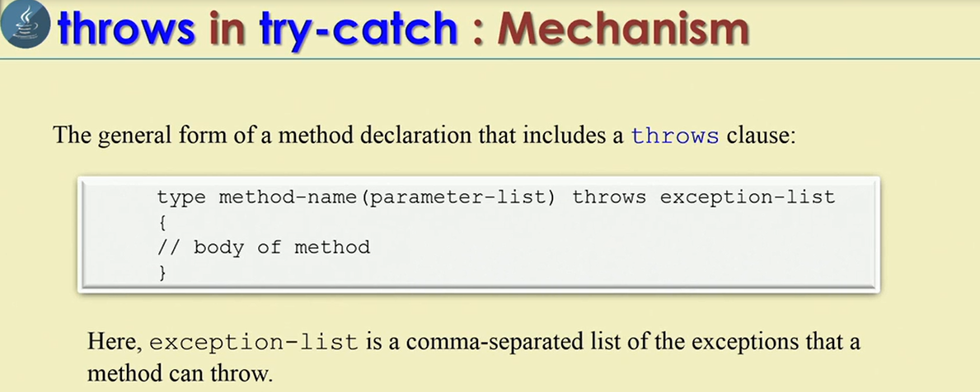

Slide 31
throw clause
There is also a throw statement available to throw an exception explicitly and catch it.
In the following program, we can creating an object of NullPointerException class and throwing it out of try block, as shown:
throw new NullPointerException(“Exception Data”);
In the above statement NullPointerException class object is created and “Exception data” is stored into its object. Then it is thrown using throw statement. Now we can catch it using catch block .

Slide 32
Throw clause
package exception;
class Sample1
{
static void demo()
{
try
{
System.out.println("Inside Demo");
throw new NullPointerException("Exception data");
}
catch(NullPointerException ne)
{
System.out.println(ne);
}
}
}
public class ThrowDemo {
public static void main(String args[])
{
Sample1.demo();
}
}

Slide 33
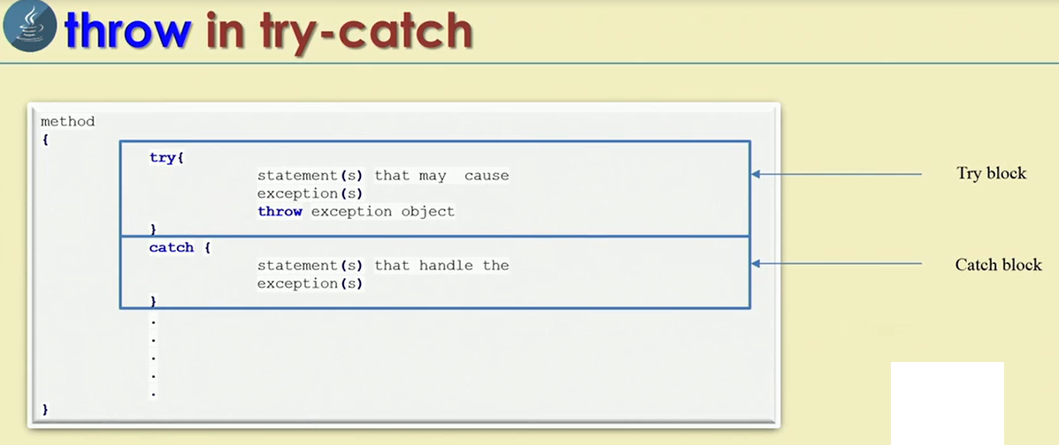

Slide 34
throw clause can be used to throw our own exceptions also. Just like exceptions available in java.
We can create our own exceptions in java called user defined exceptions and we need throw clause to throw these exceptions
Types of exceptions:
Built in exceptions
User defined exceptions.
https://docs.oracle.com/javase/7/docs/api/java/lang/RuntimeException.html
https://www.geeksforgeeks.org/types-of-exception-in-java-with-examples/

Slide 35
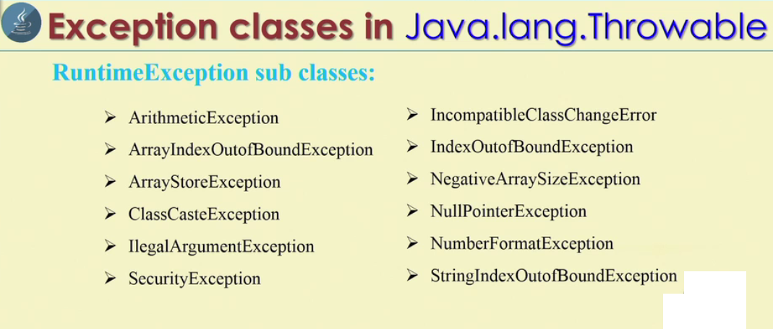

Slide 36
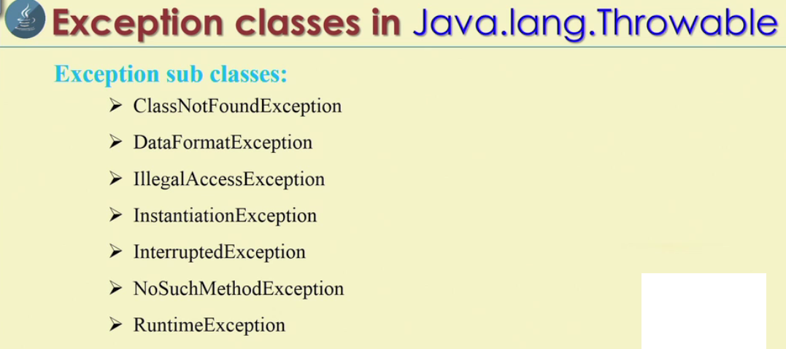

Slide 37
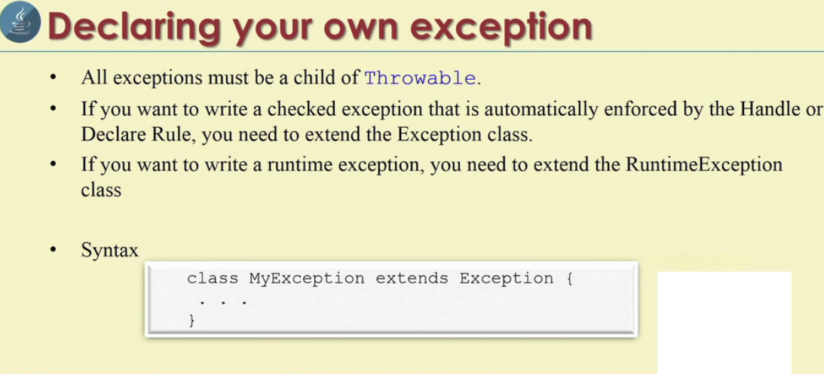

Slide 38
User defined Exception
class InvalidPinException extends Exception
{
public InvalidPinException(String s)
{
// Call constructor of parent Exception
super(s);
}
}
public class Main
{
void atmPinCheck(int pin) throws InvalidPinException{
if(pin!=1234){
throw new InvalidPinException("Invalid PIN");
}
}
public static void main(String args[])
{
Main obj = new Main();
try
{
obj.atmPinCheck(2345);
}
catch (InvalidPinException ex)
{
System.out.println("Caught the exception");
System.out.println(ex.getMessage());
}
}
}

Slide 39
package exception;
class InsufficientFundException extends Exception
{
private double amount;
public InsufficientFundException(double amount)
{
this.amount=amount;
}
public double getAmount()
{
return amount;
}
}
class CheckingAccount
{
private double balance;
public double getBalance() {
return balance;
}
public int getNumber() {
return number;
}
private int number;
public CheckingAccount(int number)
{
this.number=number;
}
public void deposit(double amount)
{
balance+=amount;
}
public void withdraw(double amount) throws InsufficientFundException
{
if(amount<=balance)
{
balance-=amount;
}
else {
double needs= amount- balance;
throw new InsufficientFundException(needs);
}

Slide 40
Bank demo
}
}
public class BankDemo {
public static void main(String[] args) {
// TODO Auto-generated method stub
CheckingAccount ch = new CheckingAccount(101);
System.out.println("Depositing 1000 rs");
ch.deposit(1000.00);
try
{
System.out.println("\n with draw 100 rs");
ch.withdraw(100.00);
System.out.println("Balance= "+ch.getBalance());
System.out.println("\n with draw 1100 rs");
ch.withdraw(1100.00);
}
catch(InsufficientFundException e)
{
System.out.println("Sorry, you are short rs="+e.getAmount());
e.getStackTrace();
}
}
}

Slide 41
Interview Questions
What is the difference between throws and throw?
Throws clause is used when the programmer does not want to handle the exception and throw it out of the method. Throw clause is used when the programmer wants to throw an exception explicitly and wants to handle it using catch block. Hence, throws and throw are contradictory.

Slide 42
We can re-throw the exception into another class
package exception;
class A
{
void method1()
{
try
{// taking a string from index 0 to 4;
String str="Hello";
// access a char at index 5 which is not there and exception will thrown
char ch = str.charAt(5);
}catch(StringIndexOutOfBoundsException sie)
{
System.out.println("Pleas see the index with in the range");
throw sie; // re- throw exception
}
}
}
public class B {
public static void main(String[] args) {
// TODO Auto-generated method stub
A a = new A();
try{
a.method1();
}
catch(StringIndexOutOfBoundsException sie)
{
System.out.println(" I caught the rethrown exception");
}
}
}

